Slide 1
Current and Emerging Approaches to Acquired Resistance for ALK/ROS1
Alice T. Shaw, MD PhD
Acquired Resistance Patient Forum
In ALK, ROS1 & EGFR Lung Cancers
September 6, 2014 | Boston

Slide 2
Background

Slide 3
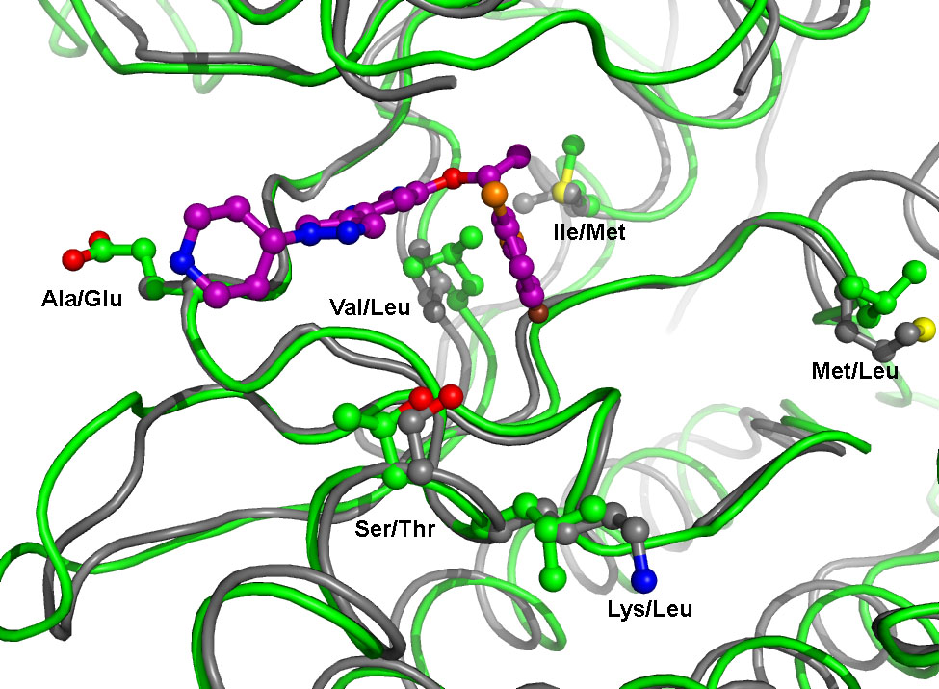
ALK and ROS1 are Similar Targets
G-Loop
N-Terminus
GK
Extended Hinge Region
C-Terminus
Kinase | L1 | L9 | N1 | N2 | N3 | N4 | N5 | H1 | H3 | H4 | H5 | H6 | H7 | H8 | H9 | H10 | H11 | H12 | H13 | C1 | C2 | C3 | C4 | C5 | C6 | C7 | C8
ALK | L | V | A | K | E | I | V | I | L | E | L | M | A | G | G | D | L | K | S | R | N | L | G | D | F | G | M
ROS1 | L | V | A | K | E | M | L | I | L | E | L | M | E | G | G | D | L | L | T | R | N | L | G | D | F | G | L
ROS1
Crizotinib
Shaw et al., ASCO 2012

Slide 4
Crizotinib Resistance in ALK+ NSCLC
Amplified
Unknown
ALK
amp
L1196M
ALK
mut
G1269A
G1269A
ALK+
S1206Y
S1206Y
G1202R
G1202R
PK/PD
1151Tins
L1152R
L1152R
No ALK amp
or mut
C1156Y
Bypass tracks

Slide 5
Crizotinib Resistance in ROS1+ NSCLC
ROS1 G2032R
Piperidine Ring
*
*
Awad et al., NEJM 368(25): 2395-2401, 2013

Slide 6
Next Generation ALK/ROS1 Inhibitors
ALK TKI | Sponsor | ROS1 Activity | Status | Ongoing Studies | Reference
Ceritinib (LDK378) | Novartis | Yes | FDA approved (4-29-2014) | Phase 3 | Shaw et al., NEJM 2014; Kim et al., ASCO 2014
Alectinib (CH5424802) | Roche | No | Investigational (Breakthrough Therapy Designation) | Phase 3 Expanded access | Seto et al., Lancet Onc 2013; Gadgeel et al., Lancet Onc 2014
AP26113 | Ariad | Yes | Investigational | Phase 2 | Gettinger et al., ASCO 2014
X-396 | Xcovery | Yes | Investigational | Phase 1 | Horn et al., ASCO 2014
TSR-011 | Tesaro | Unk | Investigational | Phase 1/2 | Weiss et al., WCLC 2013
RXDX101 (NMS-E628) | Ignyta | Yes | Investigational | Phase 1 | De Braud et al., ASCO 2014
CEP-37440 | Teva | Unk | Investigational | Phase 1 | NCT01922752
PF-06463922 | Pfizer | Yes | Investigational | Phase 1/2 | Zou et al., EORTC-AACR-NCI 2013
Notes:
6

Slide 7
Next Generation ALK Inhibitors are Effective in Crizotinib Resistance

Slide 8
Antitumor Efficacy of Ceritinib
NSCLC with prior ALKi
NSCLC ALKi naïve
N=228*
#
#
#
Change from baseline in sum of longest diameters (%)
##
#
#
#
#
#
#
#
#
#
#
#
#
#
#
#
#
#
#
#
#
#
#
#
#
#
#
#
#
#
#
#
#
#
#
#
#
#
#
#
#
#
#
#
#
#
#
#
#
#
#
#
#
#
#
#
#
#
#
#
#
#
#
#
#
#
#
#
#
#
#
#
#
#
#
#
#
#
#
#
#
#
#
#
#
#
#
#
#
#
#
#
#
#
#
#
#
#
#
#
#
#
#
#
#PFS event
#
#
#
#
#
#
#
#
#
#
#
#
#
*Patients with measurable disease at baseline and at least 1 post baseline assessment without unknown response for target lesion or overall response
Kim et al., ASCO 2014

Slide 9
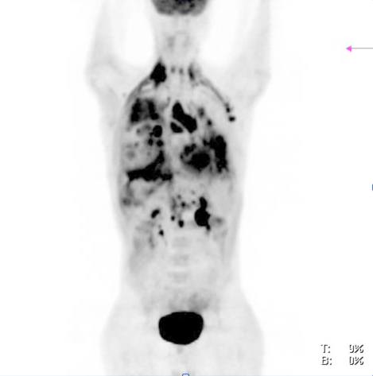
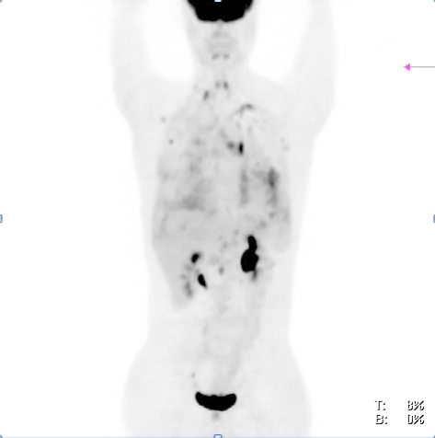
Rapid Response to Ceritinib
Baseline
After 3.5 weeks
Shaw et al., NEJM 370(13): 1189-97

Slide 10
Similar Efficacy with Alectinib
Gadgeel et al., Lancet Onc 2014, online

Slide 11
EGFR TKIs are Superior to First-Line Chemotherapy in EGFR+ Patients
Comparison of Next Generation ALK TKIs in Crizotinib-Resistant ALK+ NSCLC
ALK TKI | Company | ORR | PFS | CNS activity | Side effects/other
Ceritinib (LDK378) | Novartis | 55% (89 of 163) confirmed | 6.9 mos | Yes | GI side effects are common. 750 mg is RP2D and MTD
Alectinib (CH5424802) | Roche | 55% (24 of 44) unconfirmed and confirmed | N/A | Yes | Well tolerated RP2D is 600 mg bid, not at MTD
AP26113 | Ariad | 69% (35 of 51) unconfirmed and confirmed | 10.9 mos | Yes | Well tolerated 10-15% early pulmonary toxicity, including gr5

Slide 12
Next Generation ALK Inhibitors Are Active in the CNS

Slide 13
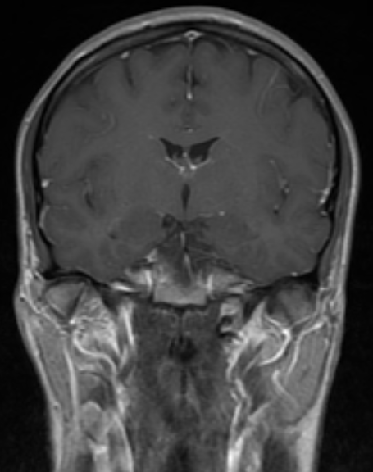
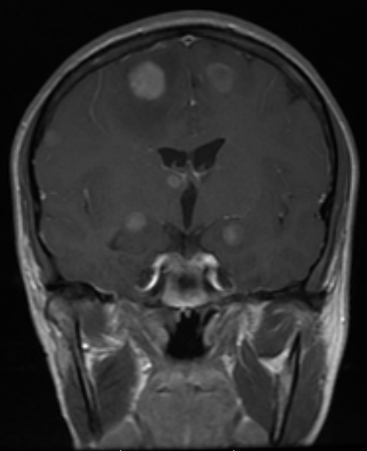
Frequent Relapses in the CNS
Baseline
After 9 months of crizotinib

Slide 14
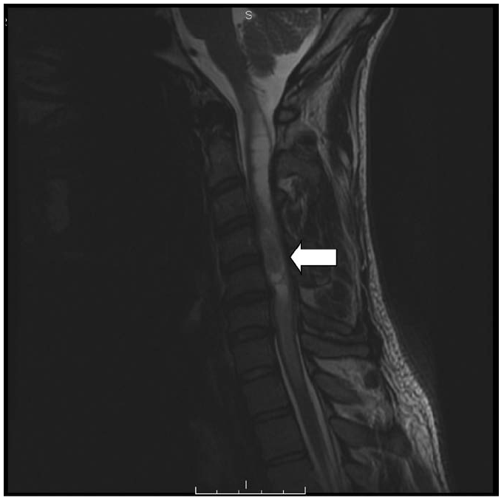
Uncommon Sites of CNS Metastasis are Becoming More Common
Gainor et al., JTO 8(12): 1570-3, 2013

Slide 15
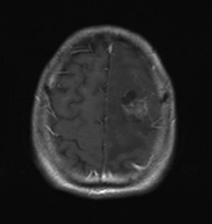
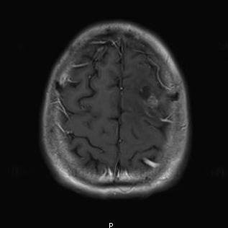
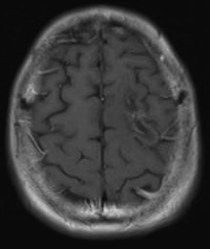
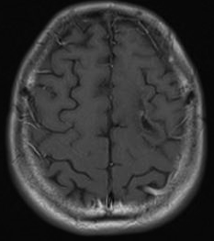
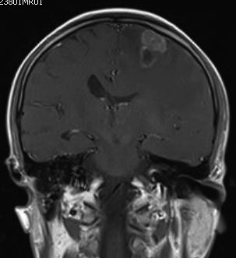
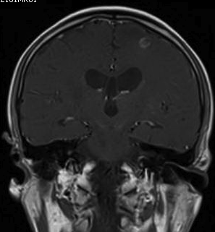
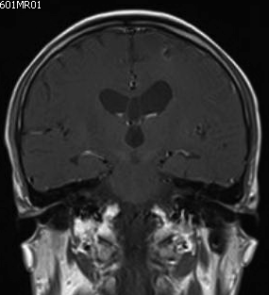
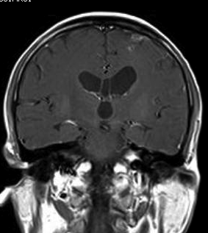
CNS Activity of Ceritinib
Pre-ceritinib
Week 8
Week 14
Week 20
36 year old male patient with lymph node, brain, adrenal, and liver metastases
Previously treated with radiation therapy, chemotherapy, and progressed on crizotinib
Patient remains on ceritinib 750 mg after 17 months
Figure courtesy of Dr Daniel Tan
Notes:
7/2011
WBRT 5000 cGy
8/2011
Pemetrexed/cisplatin
8/2011
Pirarubicin/cisplatin + adenovirus type 5
9/2011
Docetaxel
Positive screen: phase 2 crizotinib trial
9/2011
Crizotinib till 8/2012
8/2012
Gemcitabine-cisplatin

Slide 16
CNS Responses with Alectinib
Ou et al., ESMO 2013; Gadgeel et al., Lancet Onc 2014, online

Slide 17
Resistance Develops to Next Generation Inhibitors

Slide 18
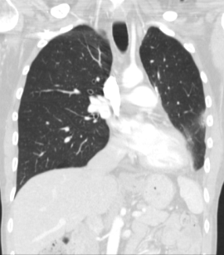
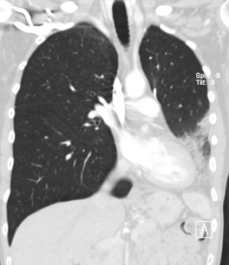
Evolution of Resistance
Baseline
After 8 weeks of crizotinib
After 34 months of crizotinib
After 12 weeks of ceritinib
After 15 months of ceritinib
WT EML4-ALK
ALK S1206Y
ALK G1202R
Friboulet et al., Cancer Discovery, online

Slide 19
Ceritinib Resistance: A Shift in the Spectrum of ALK Resistance Mutations
Patient | ALK status at time of crizotinib resistance | ALK status at time of ceritinib resistance
MGH011 | S1206Y | G1202R
MGH015 | WT | WT
MGH023 | WT | F1174C
MGH034 | WT | WT
MGH049 | WT | WT
MGH051 | WT | G1202R
MGH057 | N/A | WT
MGH061 | WT | WT
JFCR013 | N/A | WT
JFCR021 | G1269A (R lung) | F1174V (L lung) G1202R (R lung)
No L1196M
or G1269A
Friboulet et al., Cancer Discovery, online

Slide 20
About One-Half of Ceritinib-Resistant Tumors Do Not Harbor ALK Resistance Mutations
Patient | ALK status at time of crizotinib resistance | ALK status at time of ceritinib resistance
MGH011 | S1206Y | G1202R
MGH015 | WT | WT
MGH023 | WT | F1174C
MGH034 | WT | WT
MGH049 | WT | WT
MGH051 | WT | G1202R
MGH057 | N/A | WT
MGH061 | WT | WT
JFCR013 | N/A | WT
JFCR021 | G1269A (R lung) | F1174V (L lung) G1202R (R lung)
Friboulet et al., Cancer Discovery, online

Slide 21
Sequential Therapy with 3 ALK Inhibitors

Slide 22
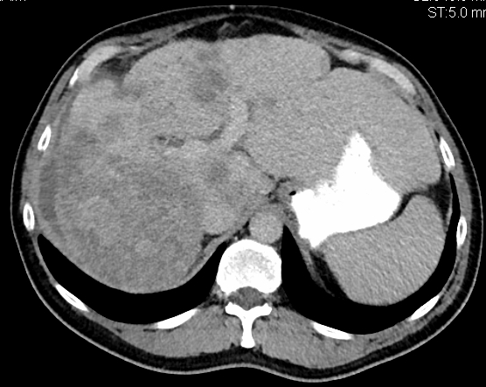
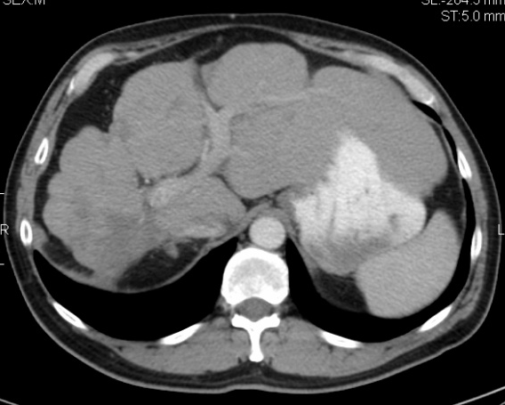
Role for Multiple Sequential ALK Inhibitors
A
Response
Response
I1171T
Response
Crizotinib
Alectinib
Ceritinib
B
Baseline
(post-criz, post-alectinib)
On ceritinib
(After 18 weeks)
Katayama et al., CCR, in press

Slide 23
Role for Multiple Sequential ALK Inhibitors CNS Disease
A
Response
Response
LMD
Response
Crizotinib
Ceritinib
More brain penetrable
ALK TKI

Slide 24
Current and Future Strategies

Slide 25
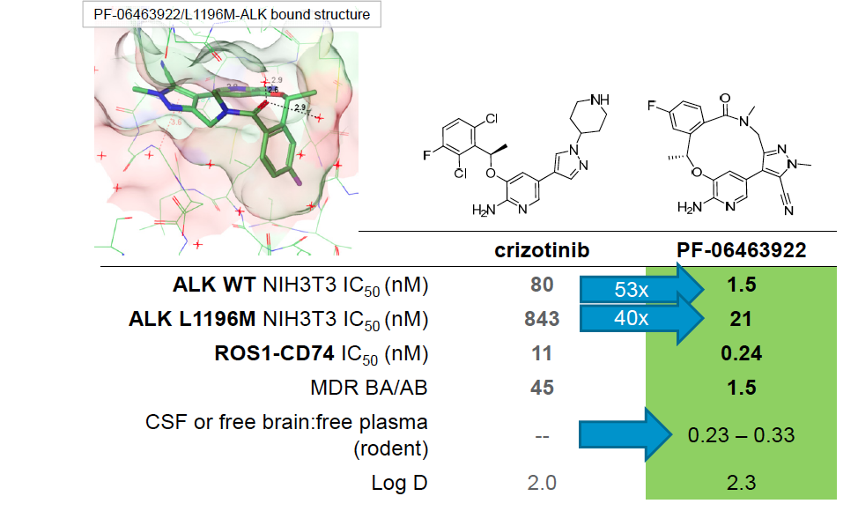
More Potent and CNS Penetrable ALK TKIs
Johnson et al., AACR-NCI-EORTC, 2013

Slide 26
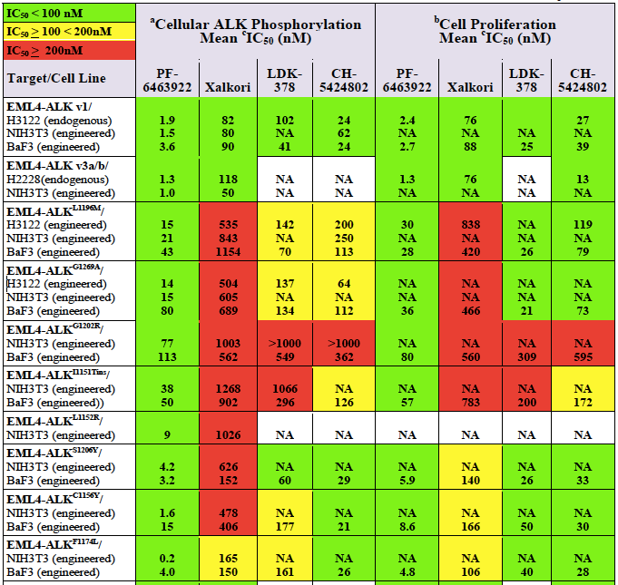
PF-06463922, a 3rd Generation ALK TKI
G1202R
F1174L
Zou et al., AACR-EORTC-NCI, 2013

Slide 27
EGFR TKIs are Superior to First-Line Chemotherapy in EGFR+ Patients
Combinatorial Therapeutics
Mechanism | Strategy | Clinical trials (examples)
EGFR activation | ALK + EGFR inhibitors | Crizotinib + erlotinib Crizotinib + dacomitinib Ceritinib + cetuximab
MET amplification | ALK + C-MET inhibitors | Ceritinib + INC280
Multiple mechanisms (or unknown) | ALK + hsp90 inhibitors | Crizotinib + ganetespib Crizotinib + AT13387 Ceritinib + AUY922
 | ALK + chemotherapy | Crizotinib + pemetrexed Alectinib + bevacizumab
 | ALK + immunotherapy | Crizotinib + ipilimumab Crizotinib + pembrolizumab Alectinib + MPDL3280A
 | ALK + CDK4/6 inhibitor | Ceritinib + LEE011

Slide 28
Summary
Next generation ALK inhibitors like ceritinib and alectinib are effective in crizotinib resistance, even in patients without a secondary resistance mutation
Next generation ALK inhibitors are a standard therapy for crizotinib-resistant ALK+ NSCLC
Next generation ALK inhibitors have activity in the CNS, particularly alectinib and PF-06463922
Strategies to overcome resistance to next generation ALK inhibitors are needed, particularly inhibitors of G1202R and combination approaches
Crizotinib resistance in ROS1+ NSCLC needs further investigation, but there are several inhibitors with potential activity (ceritinib, PF-06463922, RXDX-101)

