Slide 1
Clinical trial design and development of highly targeted agents in the molecular oncology era
Gideon Blumenthal, MD
FDA Office of Hematology Oncology Products
Acquired Resistance Patient Forum
In ALK, ROS1 & EGFR Lung Cancers
September 6, 2014 | Boston

Slide 2
Disclaimers
Opinions expressed herein are my own and not necessarily those of the FDA or U.S. government

Slide 3
Outline of presentation
FDA history (in a nut-shell) and expedited programs
Lung cancer: where we have been
Novel trial designs
How do we get more patient input into drug development

Slide 4
FDA and expedited programs

Slide 5
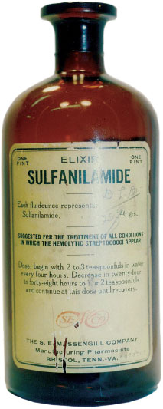
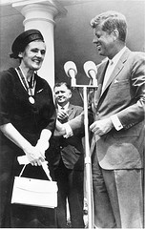
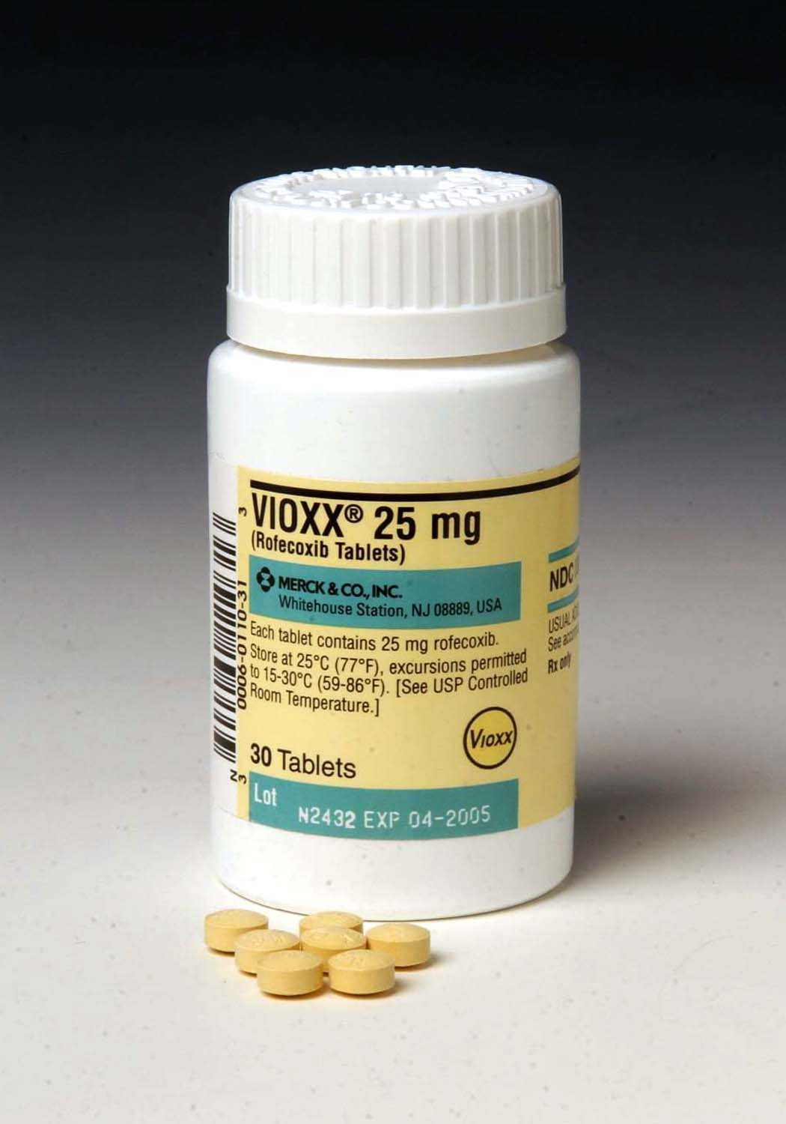
A (highly condensed) FDA timeline
Breakthrough designation
1906
1938
1962
1983
1992
2007
2012
Pure Food and Drug Act (Labeling)
Food Drug and Cosmetic Act (Safety)
Kefauver-Harris Amendment to FD&C
(Safety and Efficacy, Substantial Evidence)
Orphan Drug Act
Subpart H (Accelerated Approval)
FDAAA
(post- marketing safety and clinical trial databases)
FDASIA
Notes:
A very brief history of some important milestones in FDA history are as follows:
In 1906, Teddy Rosevelt signed the pure food and drug act, after being repulsed by slaughterhouse practices described by muckracking journalists such as Upton Sinclair is his book ‘the Jungle’. The purpose of this act was to prevent adulteration or misbranding of food and drugs
In 1938, after over 100 deaths occurred when diethelyne glycol was used as the solvent in sulfanilamide elixir, FDR signed the FD&C Act, which for the 1st time required safety testing prior to marketing
In 1962, president Kennedy signed the Kefauver-Harris amendment following the Thalidomide debacle. This is a picture of Kennedy with FDA medical Officer Frances Kelsey who was awarded the presidential medal of honor after she would not approve thalidomide because the safety data was inadequate. it was the 1962 Kefauver-Harris Amendments to FD&C act that allowed for FDA to regulate clinical research involving drugs.
In 1983, President Reagen signed the orphan drug act to facilitate the development of drugs to treat rare diseases.
Stemming from the HIV crises, The 1992 Subpart H regulations allowed for accelerated approval of drugs based on surrogate endpoints for serious and life threatening illness with unmet medical need.
Arising from the vioxx crisis, the FDAAA act included provisions for post-marketing safety and clinical trial databases.
Most recently in July of 2012, President Obama signed the FDASIA act, which among other things creates a new ‘breakthrough therapy” pathway for groundbreaking drugs..

Slide 6
FDA Expedited Programs
Breakthrough Therapy
Priority Review
Accelerated Approval
Fast Track
Non-Clinical
Early
Clinical
Registration Trial(s)
NDA/BLA
Submission
APPROVAL
IND
Submission
SPA
FDA Review
Dose Exploration / Prelim Activity
Efficacy and Safety Data

Slide 7
What is breakthrough therapy designation?
For a drug which is intended alone or in combination to treat a serious or life threatening disease and preliminary clinical evidence indicates that the drug may demonstrate substantial improvement over existing therapies
For transformative, “knock your socks off” treatments
“All hands on deck” approach

Slide 8
Approval Pathways for Drugs and Biologics
Regular Approval
Accelerated Approval
Substantial evidence from adequate and well controlled trial(s)
Based on improvement in a direct measure of clinical benefit:
Longer life, better life, or established surrogate
Not a lowering of the evidence standards
Based on improvement in surrogate endpoint reasonably likely to predict clinical benefit over available therapy
Need post-marketing studies to confirm benefit

Slide 9
Lung Cancer approvals in the last 20 years

Slide 10
FDA approvals (not targeted/ molecularly enriched) for drugs to treat patients with advanced NSCLC in the last 20 years
1st Line Unselected | Year
Vinorelbine + cisplatin | 1995
Gemcitabine + cisplatin | 1996
Paclitaxel + cisplatin | 1998
Docetaxel + cisplatin | 2002
Bevacizumab + cisplatin + paclitaxel (non-squam) | 2006
Pemetrexed + cisplatin (non-squam) | 2008
Nab-paclitaxel + carboplatin | 2013
Maintenance (unselected) | Year
Pemetrexed (non-squam) | 2009
Erlotinib | 2010
2nd Line + Unselected | Year
Docetaxel | 1999
Vinorelbine | 2001
Pemetrexed (non-squam) | 2004
Erlotinib | 2004
Improvement of symptoms for obstructing tumor | Year
Porfimer sodium and photodynamic therapy | 1998

Slide 11
FDA approvals for advanced NSCLC for targeted therapies in molecularly enriched populations
drug | patient population | accelerated approval | regular approval
crizotinib | ALK+ | 2011 | 2013
erlotinib | EGFR mutation + |  | 2013
afatinib | EGFR mutation + |  | 2013
ceritinib* | ALK+ | 2014
* First lung cancer drug approved under new breakthrough designation program

Slide 12
Example of expedited program: ceritinib
January 2011: First in human phase 1 initiated
March 2013: Breakthrough Therapy designation
November 2013: New Drug Application Submitted
April 2014: Approved for patients with ALK rearrangement who progressed on crizotinib based on durable response rates (45-55%) in 163 patients in an expansion of the phase 1 study

Slide 13
Novel Trial Designs and Endpoints

Slide 14
Randomized Study
Single arm versus randomized trials
N=800-1200
p53
Platinum doublet
Endpoint: Overall Survival or Progression-Free Survival
EGFR
MET
ROS1
KRAS
ALK
Platinum doublet
+ drug X
Single Arm Study
Targeted
Therapy
Endpoint: Objective Response Rate
ALK
N=100-200

Slide 15
Pros and Cons of single arm trials
PRO
CON
Smaller, faster
More feasible to enroll patients with rare tumor types
Can use response rate to look for large effects
Confident in drug effect because tumors do not naturally regress
No randomized comparison
Could lead to bias in selecting patients
Do not get good information on longer term outcomes (progression delay, survival)
Do not get good comparative safety data

Slide 16
FDA meta-analysis 14 trials of >12,000 patients: Response rate correlated with progression free survival
Blumenthal et al, ASCO 2014

Slide 17
Master Protocol: Umbrella vs. Basket Trial
Umbrella
Basket
Test impact of different drugs on different mutations in a single type of cancer
BATTLE
I-SPY2
Lung-MAP Squamous Lung Master
Test the effect of a drug(s) on a single mutation(s) in a variety of cancer types
Imatinib Basket
BRAF+
NCI MATCH

Slide 18
Umbrella Trial: Lung MAP Squamous 2nd Line
PD-L1 mAb
Broad Biomarker Profiling: NGS,IHC
Non-Match
Docetaxel
PIK3CA
mut
cdk4/6 CCND1 mut, del, amp
FGFR
mut, amp, fusi
HGF
Met pos By IHC
PI3K inh
Doce-taxel
CDK4/6 inh
Doce-taxel
FGFR
TKI
Doce-taxel
HGF mAb
+
erlotinib
Erlotinib
PFS/
PFS/
Interim Analysis (Phase 2 part): IRR PFS; futility/efficacy
Final Analysis (Phase 3 part): Co-primary OS (powered) and PFS

Slide 19
Efforts to involve patients

Slide 20
FDA Patient Focused Drug Development meeting: June 28, 2013
Public meeting to hear perspectives from lung cancer patients about disease, impact on daily life, and currently available therapies
Part of Patient-Focused Drug Development Program, and FDA commitment under the fifth authorization of Prescription Drug User Fee Act (PDUFA V)
Voice of the Patient Report: http://www.fda.gov/downloads/ForIndustry/UserFees/PrescriptionDrugUserFee/UCM379698.pdf

Slide 21
Need better Patient Reported Outcomes (PRO) to capture the clinical benefit of a response
Validated patient reported outcome measures and implementation within early clinical studies to align radiographic responses with symptomatic benefit
Ongoing efforts to qualify a lung cancer symptom specific PRO as a drug development tool

Slide 22
Parting thoughts
FDA and patients, physicians, drug and device cos share mutual interests: rapid development and approval of highly effective and safe anti-cancer drugs for patients
FDA expedited programs facilitate the development of transformative therapies
Need to study novel endpoints, clinical trial designs, PROs, in this new age of molecular oncology
Patients play a crucial role in guiding drug development

Slide 23
Thank you

