Slide 1
Novel EGFR Inhibitors in the Setting of Acquired Resistance
Pasi A. Jänne, MD, PhD
Acquired Resistance Patient Forum
In ALK, ROS1 & EGFR Lung Cancers
September 6, 2014 | Boston

Slide 2
EGFR TKI as Standard First-Line Therapy for Patients with EGFR Mutation
Study | Drug | N (EGFR mut) | RR (TKI vs. chemotherapy) | Median PFS (mos)
IPASS | Gefitinib | 261 | 71.2% vs 47.3% | 9.8
First-SIGNAL | Gefitinib | 42 | 84.6% vs 37.5% | 8.4
WJTOG 3405 | Gefitinib | 198 | 62.1% vs 32.2% | 9.2
NEJGSG002 | Gefitinib | 177 | 73.7% vs 30.7% | 10.3
EURTAC | Erlotinib | 86 | 58.0% vs 15.0% | 9.7
OPTIMAL | Erlotinib | 82 | 83.0% vs 36.0% | 13.1
Lux Lung 3 | Afatinib | 230 | 56.1% vs 22.6% | 11.1
Mok TS, et al. N Engl J Med 2009;361:947–957; Lee JS, et al. Presentation at WCLC 2009 (PRS.4);Mitsudomi T, et al. Lancet Oncol 2010;11:121–128;Maemondo M, et al. N Engl J Med 2010;362:2380–2388; Rossell et al. Lancet Oncol 2012; Zhou et al. Lancet Oncology 2011; Yang et al. ASCO 2012

Slide 3
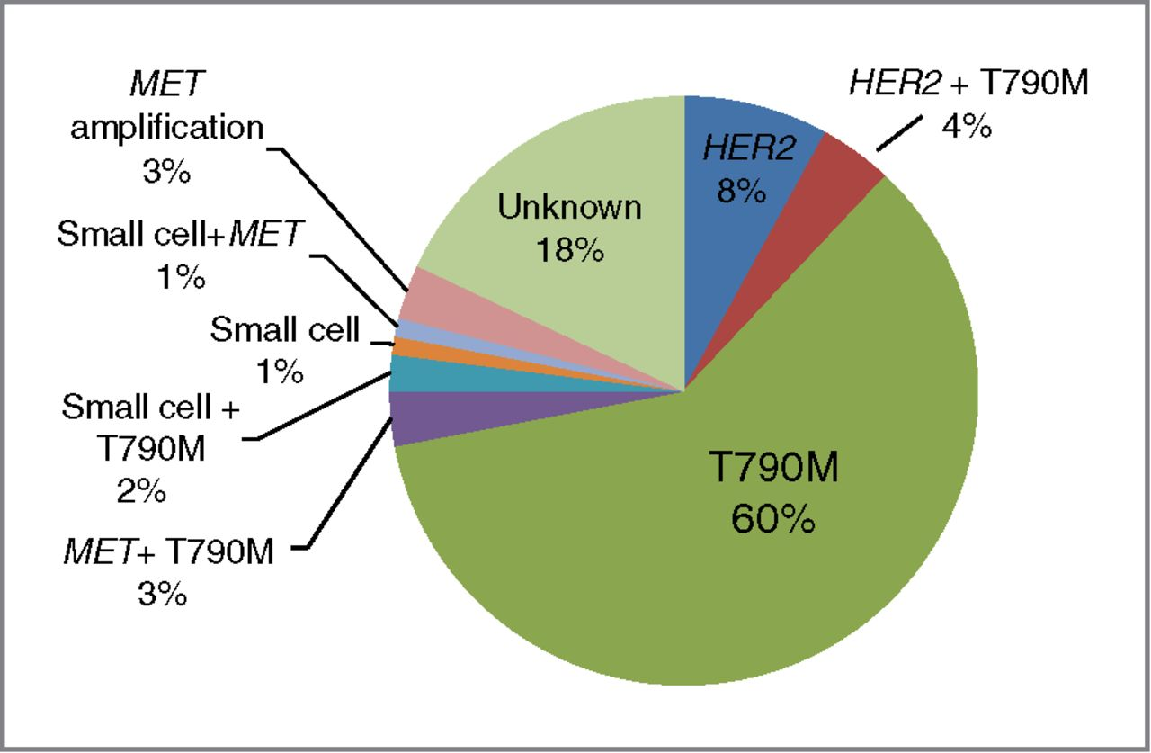
The relative frequencies of the various mechanisms of acquired resistance
Yu H A et al. Clin Cancer Res 2013;19:2240-2247

Slide 4
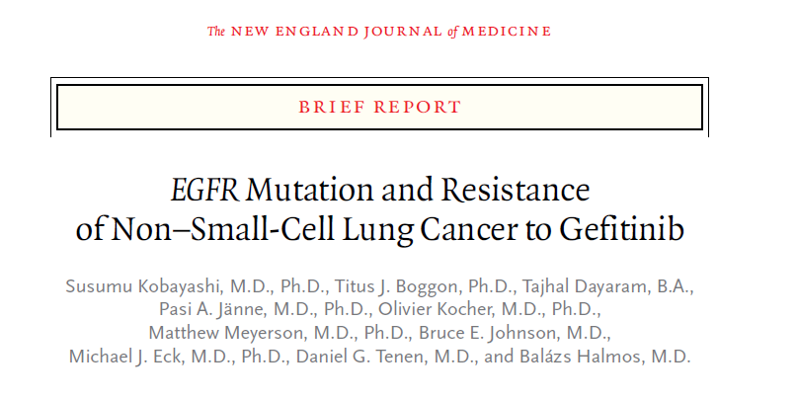
N Engl J Med. 2005 Feb 24;352(8):786-92.

Slide 5
Clinical EGFR Inhibitors
Drug | Stage | Covalent | Overcome T790M | Structure
Gefitinib | Approved | No | No | Quinazoline
Erlotinib | Approved | No | No | Quinazoline
Dacomitinib | Phase III | Yes | No | Quinazoline
Afatinib | Approved | Yes | No | Quinazoline

Slide 6
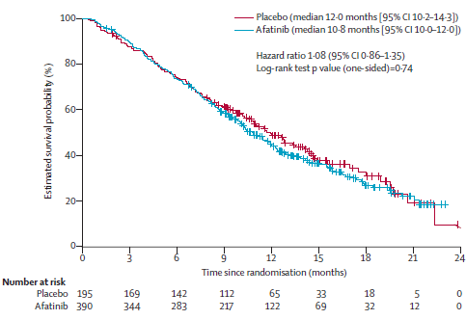
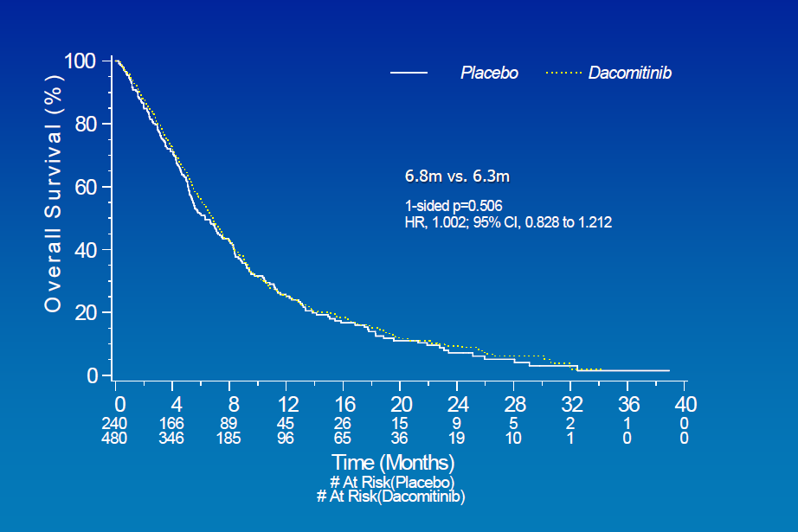
Afatinib & Dacomitinib in patients previously treated with EGFR Inhibitors
LUX Ling 1 – Afatinib vs Placebo
PFS: 3.3 vs. 1.1 months
RR < 10%
BR.26 – Dacomitinib vs Placebo
PFS: 2.7 vs. 1.4 months
RR < 10%
Miller et al. Lancet Oncol 2013; Ellis et al. ASCO 2014

Slide 7
T790M
100x
T790M
10x
Relative IC50
Wt
Wt
1x
EGFRm
EGFRm
Gefitinib
Afatinib
Geoff Oxnard
Notes:
7

Slide 8
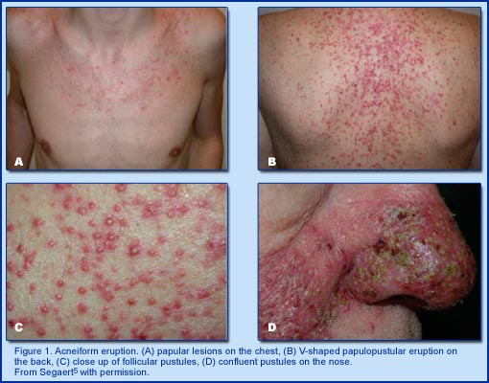
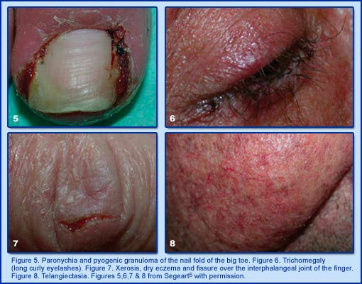
Skin Toxicity from EGFR Inhibitors from Inhibiting Wild Type EGFR
Acneiform Rash
Paronychia, Trichomegaly &
Skin fissure
http://www.managecrc.com

Slide 9
EGFR Timeline
EGFR mutations identified
2004
EGFR T790M reported
1990s
2005
2009
Quinazoline EGFR inhibitors discovered
Gefitinib approved for EGFR mutant NSCLC
Erlotinib approved for NSCLC
All current clinical EGFR inhibitors were identified
before EGFR mutations
All are quinazolines or quinazoline derivatives

Slide 10
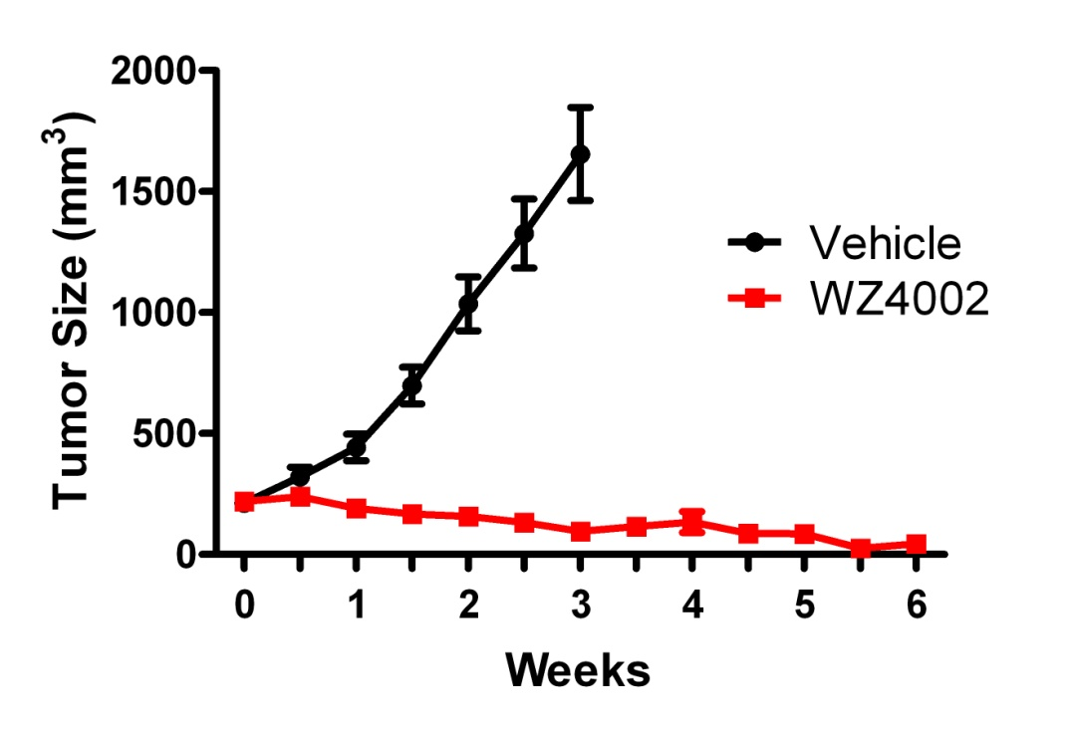
Properties of Mutant Selective EGFR Inhibitors
Increased potency in T790M bearing models compared to current clinical agents
Less effective against WT EGFR
PC9 GR (EGFR Del19/T790M)
A431 (EGFR WT; amplified)
Zhou et al. Nature 2009
Potent and Mutant Selective in vivo

Slide 11
T790M
100x
T790M
Wt
10x
Relative IC50
Wt
Wt
1x
EGFRm
EGFRm
EGFRm
T790M
Gefitinib
Afatinib
AZD9291
Geoff Oxnard
Notes:
11

Slide 12
Clinical EGFR Inhibitors
Drug | Stage | Covalent | Overcome T790M | Structure
Gefitinib | Approved | No | No | Quinazoline
Erlotinib | Approved | No | No | Quinazoline
Dacomitinib | Phase III | Yes | No | Quinazoline
Afatinib | Approved | Yes | No | Quinazoline
AP26113 | Phase I/II | No | No | Pyrimidine
CO-1686 | Phase I/II | Yes | Yes | Pyrimidine
AZD9291 | Phase I/II | Yes | Yes | Pyrimidine
HM61713 | Phase I | Yes | Yes | Pyrimidine

Slide 13
Irreversible Pyrimidine based EGFR Inhibitors
WZ4002
CO-1686
AZD9291
Zhou et al. Nature 2009; Walker et al. Cancer Discovery 2013; Cross et al. Cancer Discovery 2014

Slide 14
AZD9291 Phase I study design
Phase I, open-label, multicenter study of AZD9291 administered once daily in Asian and Western patients with advanced NSCLC who have documented radiological progression while on prior therapy with an EGFR-TKI (AURA; NCT01802632)
Objectives
Primary: safety and tolerability in EGFR-TKI-refractory patients
Secondary include: define maximum tolerated dose, pharmacokinetics, preliminary efficacy
Escalation
Not preselected by T790M status
Rolling six design
Cohort 1 20 mg
Cohort 2 40 mg
Cohort 3 80 mg
Cohort 4 160 mg
Cohort 5 240 mg
Expansion
Enrollment by local testing followed by central laboratory confirmation* of T790M status or by central laboratory testing alone
T790M+
T790M+
T790M+
T790M+
T790M+
T790M-
T790M-
T790M-
1st-line EGFRm+
1st-line EGFRm+
Biopsy
Biopsy
Tablet
*cobas® EGFR Mutation Test (Roche Molecular Systems)

Slide 15
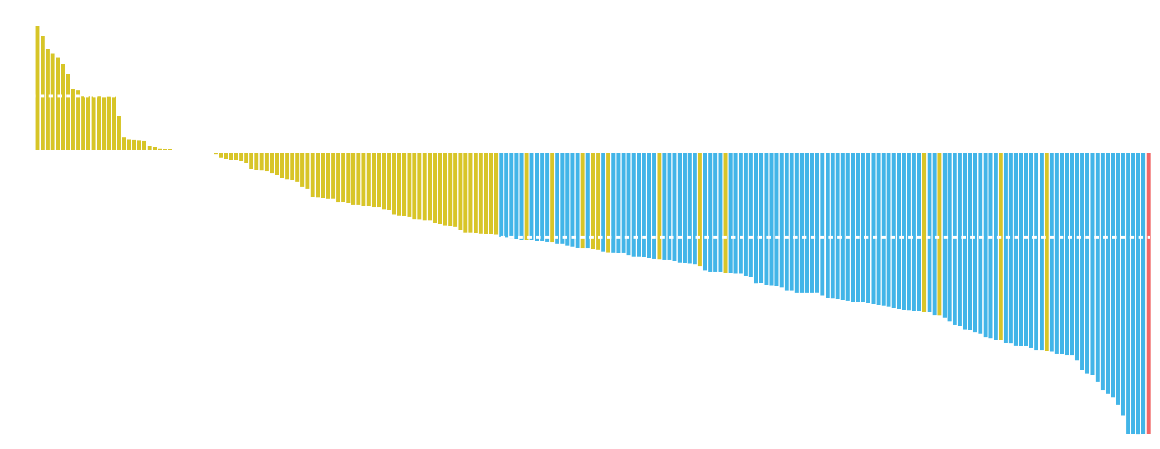
Response rate* in overall population
40
Best percentage change from baseline in target lesion:
all evaluable patients, escalation and expansion (N=205)
20
#######
0
-20
-40
Complete response
Partial response*
-60
Non-response
-80
First patient dosed Mar 6, 2013
Longest response >9 months ongoing at time of data cutoff
ORR* = 53% (109/205; 95% CI 46%, 60%); no difference in ORR by race
Overall disease control rate (CR+PR+SD) = 83% (171/205; 95% CI 78%, 88%)
-100
 | 20 mg | 40 mg | 80 mg | 160 mg | 240 mg
N (205) | 20 | 57 | 61 | 55 | 12
ORR | 55% | 44% | 54% | 58% | 67%
*Includes confirmed responses and responses awaiting confirmation; #represents imputed values. Population: all dosed patients with a baseline RECIST assessment and an evaluable response (CR, PR, SD, or PD), N=205 (from 232 dosed patients, 27 patients with a current non-evaluable response are not included). CI, confidence interval; CR, confirmed complete response; ORR, overall response rate; PD, progressive disease; PR, confirmed partial response; RECIST, Response Evaluation Criteria In Solid Tumors; SD, stable disease
Jänne ASCO 2014

Slide 16
Response rate* in T790M+ (central test)
40
Best percentage change from baseline in target lesion:
T790M+ evaluable patients, expansion cohorts only (N=107)
Best percentage change from baseline in target lesion: all evaluable T790M+ patients, Part B
20
# #
D D
0
D
D
D
D
D
D
-20
D
D
D
-40
D
D
D
20 mg QD
D
D
40 mg QD
D
D
-60
80 mg QD
D
D
160 mg QD
D
240 mg QD
D
D
-80
-100
ORR* = 64% (69/107; 95% Cl 55%, 73%) in patients with EGFR T790M+ NSCLC
Overall disease control rate (CR+PR+SD) = 94% (101/107; 95% CI 88%, 98%)
 | 20 mg | 40 mg | 80 mg | 160 mg | 240 mg
N (107) | 10 | 29 | 34 | 28 | 6
ORR | 50% | 62% | 68% | 64% | 83%
*Includes confirmed responses and responses awaiting confirmation; #represents imputed values Population: all dosed centrally confirmed T790M+ patients with a baseline RECIST assessment and an evaluable response (CR/PR, SD, or PD), N=107 (from 120 T790M+ patients; 13 patients with a current non-evaluable response are not included). D, discontinued; QD, once daily

Slide 17
Safety summary*
No dose-limiting toxicities have been seen at any dose evaluated
MTD has not been defined and there are no observed differences in toxicity by race
Patients with an AE, n (%) | 20 mg (N=21) | 40 mg (N=57) | 80 mg (N=74) | 160 mg (N=60) | 240 mg (N=20) | Total (N=232)
Any AE | 21 (100) | 52 (91) | 65 (88) | 57 (95) | 20 (100) | 215 (93)
Any AE Grade ≥3 | 4 (19) | 16 (28) | 16 (22) | 15 (25) | 5 (25) | 56 (24)
AE leading to dose reduction | 0 | 1 (2) | 0 | 1 (2) | 2 (10) | 4 (2)
AE leading to discontinuation | 1 (5) | 1 (2) | 3 (4) | 4 (7) | 1 (5) | 10 (4)
Serious AE# | 3 (14) | 10 (18) | 16 (22) | 15 (25) | 1 (5) | 45 (19)
Maximum grade of AEs by dose
*Data here and on following slides are preliminary from an ongoing study; do not include first-line or tablet cohorts; #total investigator drug-related serious AEs, n=12 (5.2%). Population: all dosed patients, N=232. AE, adverse event; MTD, maximum tolerated dose

Slide 18
Ongoing Phase 1/2 FIH study of CO-1686 (NCT01526928)
Key eligibility criteria
Advanced or recurrent NSCLC with a documented activating EGFR mutation
Prior treatment with EGFR-directed therapy
Recent biopsy available or willing to undergo a new on-study biopsy
Phase 2 only
Disease progression while on treatment with EGFR-directed therapy
T790M-positive biopsy at the time of entering study
Phase 1 (Dose-escalation period)
Phase 2 (RP2D evaluation) TIGER X Expansion Cohorts
2nd-line patients
PD upon 1 immediate prior TKI
500 mg BID
CO-1686 Treatment
21-day cycles; escalate to MTD
625 mg BID
>2nd-line patients
PD upon ≥2 TKI or chemotherapy
750 mg BID
Primary outcome measures
Phase 1: Safety; PK profile
Phase 2: ORR; DoR per RECIST v1.1
DoR, duration of response; ORR, objective response rate; FIH, first in human; MTD, maximum tolerated dose PK, pharmacokinetic; RP2D, recommended Phase 2 dose

Slide 19
CO-1686 Phase I Study: Dose Levels
BID dose
(N)
FB formulation
BID dose
(N)
HBr formulation
Exposure
1000 mg (6)
750 mg
(12)
625 mg (17)
500 mg (28)
900 mg (19)
10 patients
transitioned
<900 mg (38)
Efficacy threshold
FB, free-base; HBr, hydrobromide salt

Slide 20
Best response in Phase 1 and early Phase 2 expansion cohort patients
Centrally confirmed T790M+ patients within therapeutic dose range (N=40)
100
*Ongoing
Change from Baseline (%)
*
*
*
*
*
*
*
*
*
*
*
*
*
*
*
*
*
ORR to date: 58%
*
*
*
*
*
*
*
*
*
*
*
*
*
*

Slide 21
Adverse events
Treatment-related adverse events* occurring in >10% of CO-1686 patients (N=72) treated at efficacious doses, n (%)
Preferred term | Grade 1 | Grade 2 | Grade 3 | Grade 4
Nausea | 14 (19) | 10 (14) | 1 (1) | 0
Hyperglycemia and IGT | 14 (19) | 8 (11) | 16 (22) | 0
Diarrhea | 14 (19) | 3 (4) | 0 | 0
Vomiting | 9 (13) | 1 (1) | 2 (3) | 0
Decreased appetite | 7 (10) | 7 (10) | 1 (1) | 0
Myalgia | 7 (10) | 1 (1) | 0 | 0
QTc prolonged | 3 (4) | 3 (4) | 5 (7) | 0
*excluding malignancy-related adverse events (eg, disease progression)
3 (4%) patients with any form of rash, all Grade 1

Slide 22
Study Design
Phase I Study to assess the safety, tolerability and pharmacokinetics and anti-tumor activity of HM61713 in NSCLC patients with EGFR mutation (NCT01588145)
Open-label study conducted at 7 centers in Korea
Objectives
Primary: safety and tolerability
Secondary: preliminary efficacy, pharmacokinetics of HM61713 and metabolites
Exploratory: biomarker study
Dose escalation part
800 mg
MTD
Progression on at least 2 prior regimens, including EGFR TKI
650 mg
Current status
500 mg
Arm A (N=42)
failure of prior TKI within 4 weeks
400 mg
300 mg
3+3 design, cohort 1-11 (N=35)
Treatment with HM61713
75-500 mg/day
250 mg
Expansion part
200 mg
Progression on prior EGFR TKI therapy
150 mg
Arm B (N=41)
failure of prior TKI before 4 weeks or more
100 mg
75 mg
Mandatory re-biopsy for EGFR T790M analysis
100 mg
50 mg
* Patients with active or symptomatic CNS metastasis were excluded.

Slide 23
Best Change from Baseline in Target Lesions : T790M+ versus T790M-
Response rate | 29.2%
Disease control rate | 75.0%
Response rate | 11.8%
Disease control rate | 55.9%

Slide 24
Mutant Selective EGFR Inhibitors
Data emerging on efficacy of three compounds (others in development)
Some differences in toxicities
CO-1686: drug induced diabetes
some need insulin
AZD9291: ILD like events in some patients
HM61713: some dyspnea nos
AZD9291 & CO-1686 have FDA breakthrough designation

Slide 25
Opportunities and Challenges
How to best identify patients with EGFR T790M ?
Tumor based analyses can be slow and biopsies not feasible in everyone
How to build upon the initial efficacy ?
Develop rationale combination approaches

Slide 26
Digital Droplet PCR for detection of tumor derived mutations in circulating free (cf) DNA
Oxnard et el. CCR 2014

Slide 27
Non-invasive disease monitoring
Stage IV NSCLC
EGFR mutant
Treatment naive
Erlotinib
150 mg
Biopsy at resistance
Circulating tumor cells
Plasma for cfDNA
Serial monitoring for EGFR activating and EGFR T790M resistance mutation in erlotinib treated EGFR mutant patients
Oxnard et al. CCR 2014

Slide 28
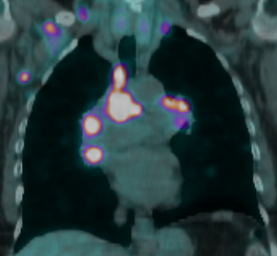
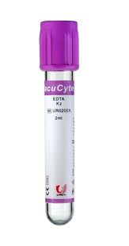
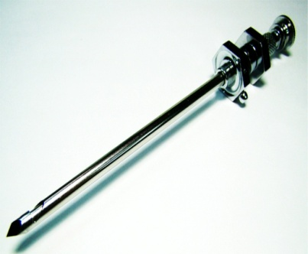
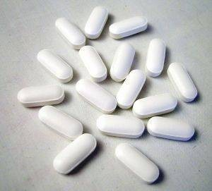
Case report: Acquired resistance
DAY 0:
CT shows marked progression on erlotinib, plasma drawn
DAY 1:
cfDNA genotyping detects
806 copies/ml of
EGFR T790M
DAY 25:
Report from rebiopsy genotyping shows EGFR T790M
DAY 31:
Patient starts treatment with an investigational EGFR inhibitor
DAY 73:
CT demonstrates a radiographic response
Sacher et al, ASCO, 2014

Slide 29
TATTON: Multi-arm phase Ib trial of AZD9291 combination therapies
Arm 1: final eligibility review² & registration
AZD9291 & MEDI4736 (PD-L1 inhibitor)
Consent of potentially eligible patient
Rolling arm allocation¹
Arm 2: final eligibility review² & registration
AZD9291 & volitinib (MET inhibitor)
Arm 3: final eligibility review² & registration
AZD9291 & selumetinib (MEK inhibitor)
¹Allocation is unbiased and semi-random based upon slot availability at time of consent
²If a patient is ineligible, but remains eligible for another arm, they will be re-allocated.
Sponsor: Astra-Zeneca, PI: Geoffrey R. Oxnard (DFCI)

Slide 30
Novel EGFR Inhibitors in the Setting of Acquired Resistance
New drugs are in clinic to treat resistance
Overcome limitations of afatinib/dacomitinib
Effective in patients with EGFR T790M
Ongoing efforts
Build rationale combinations
Test in both EGFR T790M + & - patients
Development of rapid assays to identify T790M

